Slide 1
Telecom Churn Analysis
Team members
Ms. Varsha R Chintamani
Mr F Mohammed Hamdhan
Ms Kajal Kumari
Ms. Himangi
Ms. S SHARMILI
Ms. Mupparam Srividya

Slide 2
FLOW CHART
Data analysis Data visualization Correlation analysis Outliers detection Treating of outliers Feature scaling Feature extraction Sampling techniques Train and test splitting Model building Model Selection Model deployment

Slide 3
Objective
Customer churn is a key business concept that determines the number of customers that stop doing business with a specific company.
The churn rate is then defined as the rate by which a company loses customers in a given time frame. For example, a churn rate of 15%/year means that a company loses 15% of its total customer base every year.
The goal is to predict the probability of churn rate for the given telecom company using the customer features

Slide 4
SUMMARY
The given dataset has 5000 customers for the specific telecom company from the 51 districts and states of Columbia and 21 features corresponds to the collected information from the customer about the type of plan they have contracted, the minutes they have talked, or the charge they pay every month.
There are 7 categorical and 13 numerical(integers, float) features where data cleaning is done by extracting the strings from the ‘area code’ and replacing the null values with mean in ‘total day charge’, ’total eve minutes ’ columns by their mean as it is numeric data
After checking for the unique value of the datatypes we can see there are 3 area code for all 51 states
Convert the categorical data into numeric datatype using Label encoder.

Slide 5
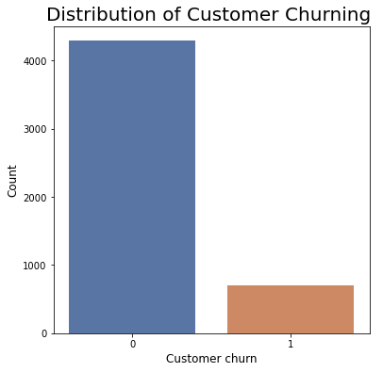
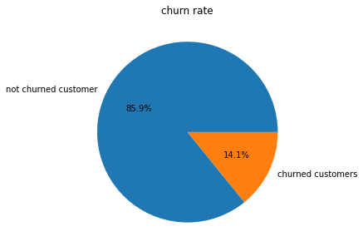
DATA VISUALIZATION
Target variable in telecom churn dataset has 2 categories 0 or 1
Churned customer 14.1%
Loyal customer 85.9%

Slide 6
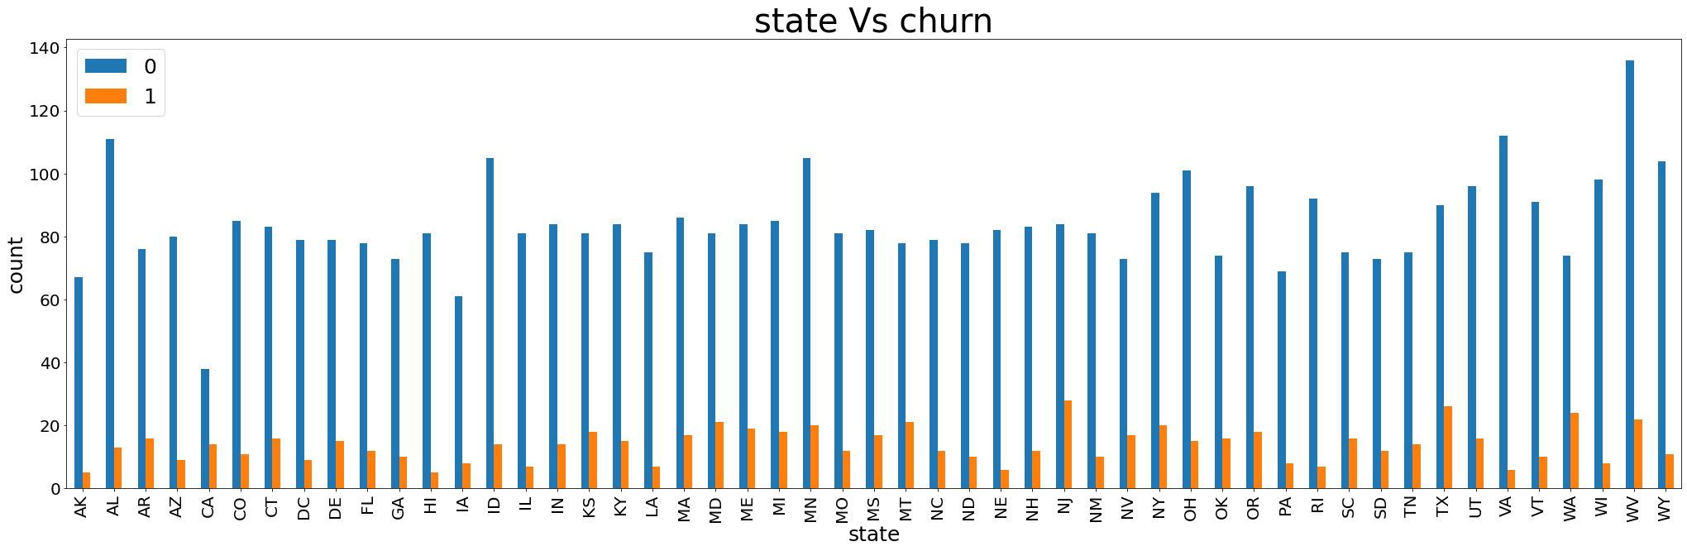
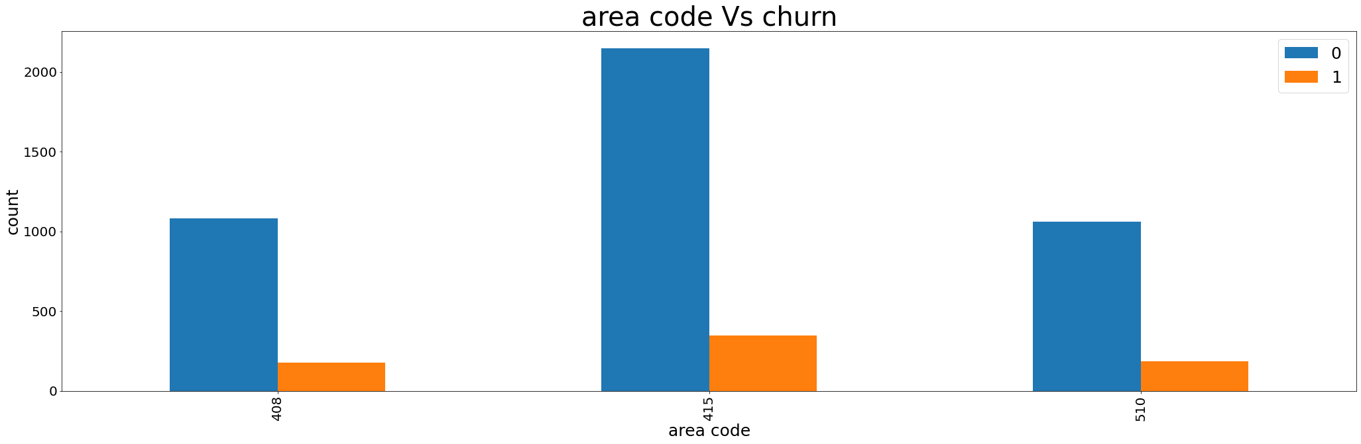
AREA CODE ANALYSIS
STATE ANALYSIS
The area code is divided as 50%, 25% and 25% for 415, 408 and 510 area codes
Churned customers are more in the area 415 compared with other areas so the telecom company needs to concentrate more on the area 415 by providing more network coverage and customer service
From the above plot we can say that the top 10 states which are higher in churn rate are NJ,MT,MN,MS,MD,NY,TX,OR,WA,WV

Slide 7
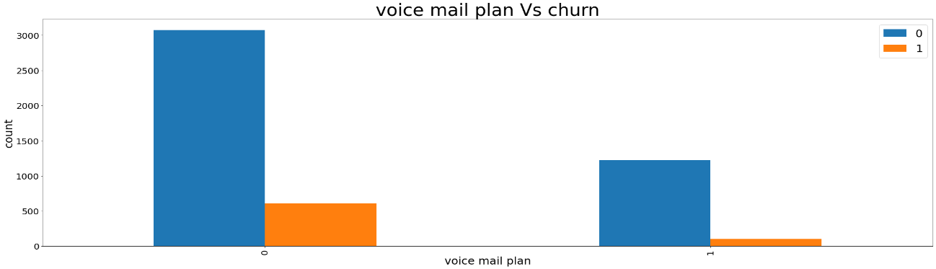
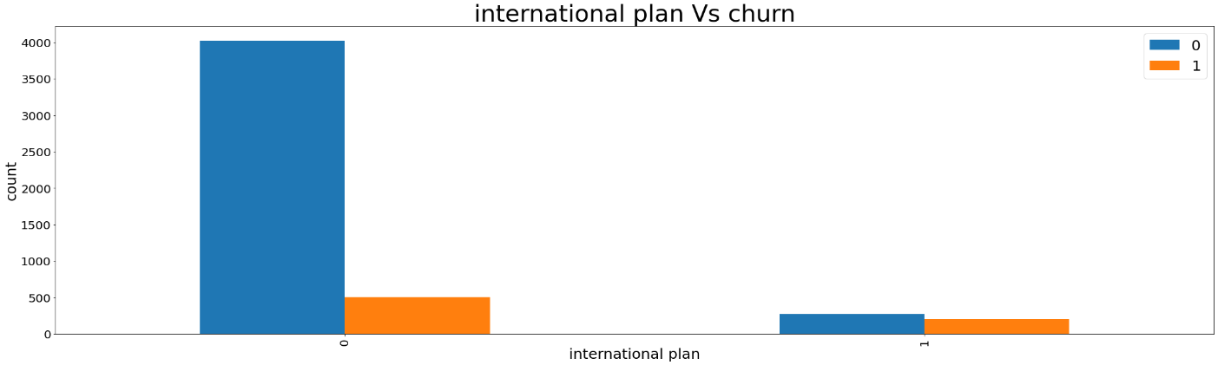
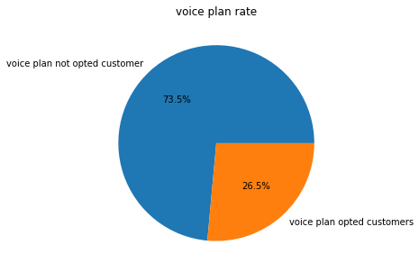
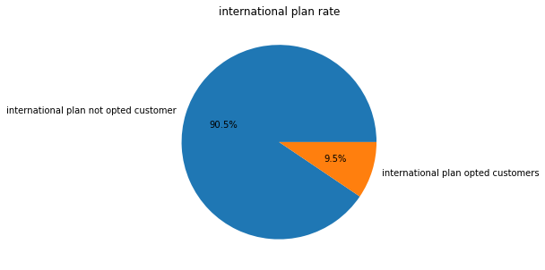
ANALYSIS OF THE CHURN RATE BASED ON THE CUSTOMERS WHO OPTED FOR VOICE MAIL PLAN OR NOT
ANALYSIS OF THE CHURN RATE BASED ON THE CUSTOMERS WHO OPTED FOR INTERNATIONAL PLAN OR NOT
The customers who opted for voice plan has higher churn rate compared to the customer who are not having the voice mail plan.
It infers the telecom company needs to work more on the voice mail plan by giving more plan benefits, more network coverage and so on to reduce the churn rate.
Churn rate is high for the customer who are opted for international plan. It means the telecom company need to concentrate more on the international plan services

Slide 8
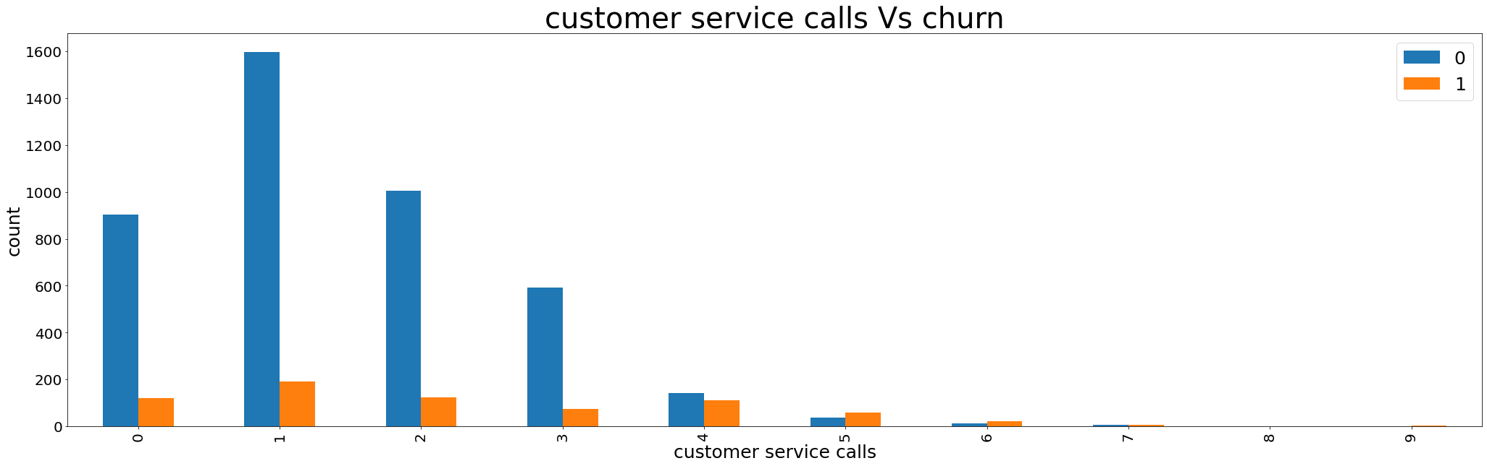
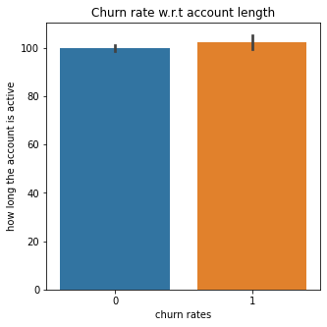
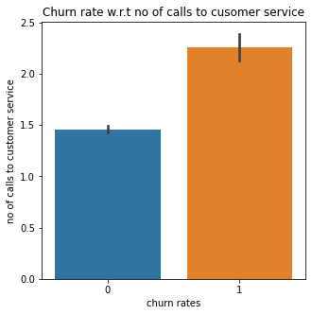
ANALYSIS OF THE CHURN RATE BASED ON THE FREQUENCY OF THE CUSTOMER SERVICE CALLS
ANALYSIS OF THE CHURN RATE BASED ON THE CUSTOMERS ACCOUNT LENGTH i.e., how long the customers account is active
Lower the calls to customer service, lower the churn rate and vice versa
The account is active for almost same time for both the
customers who are churned and not churned.

Slide 9
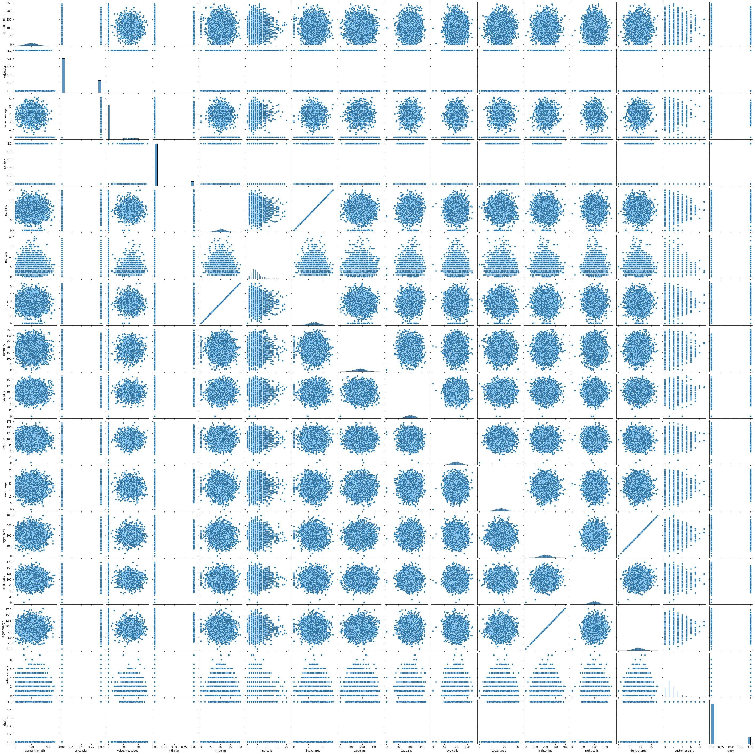
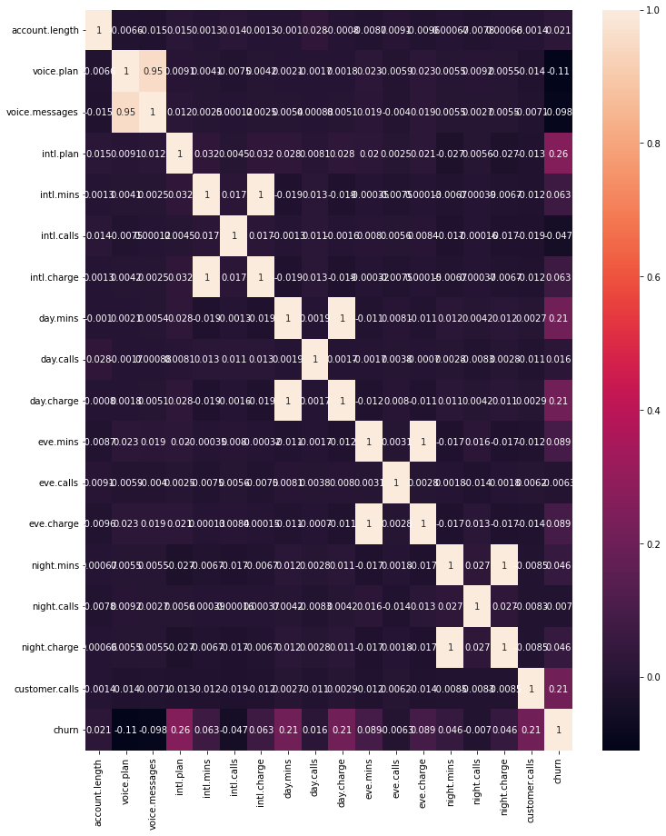
PAIR PLOT
HEAT MAP
Correlation exists between ,international minutes and international charge, day charge and day minutes, eve charge and eve minutes, night charge and night minutes

Slide 10
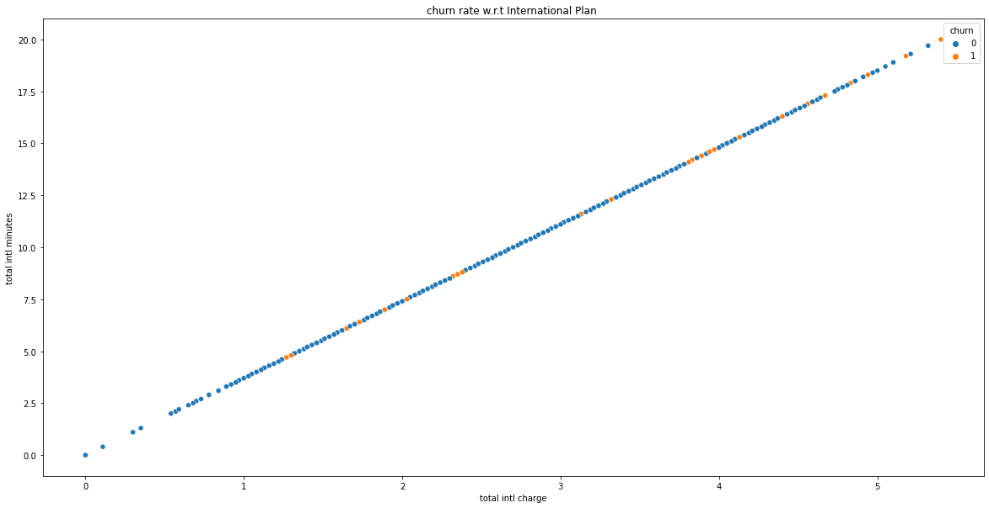
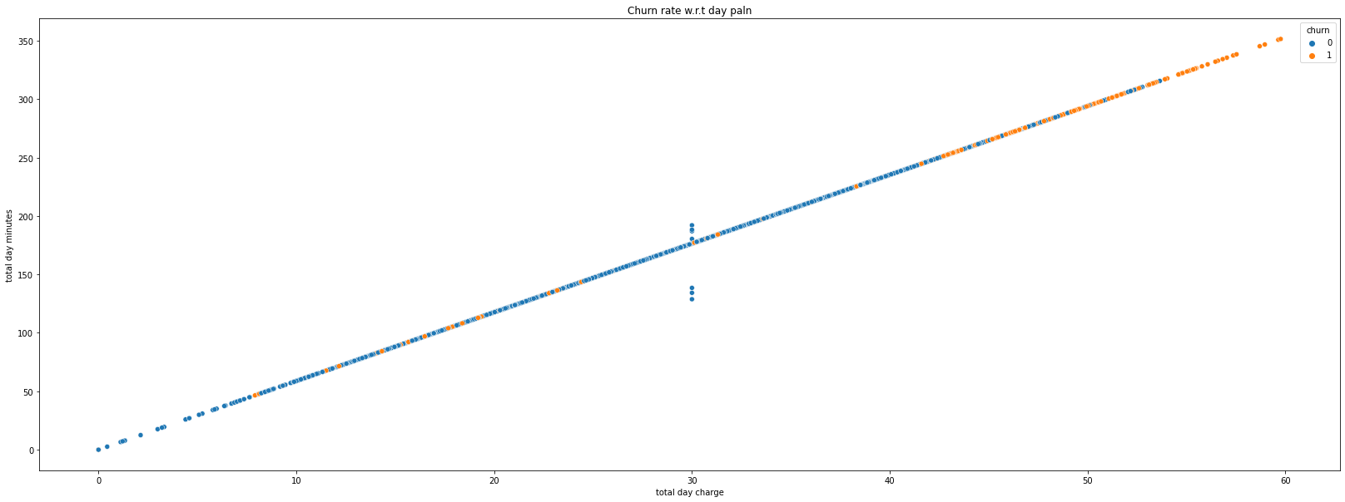
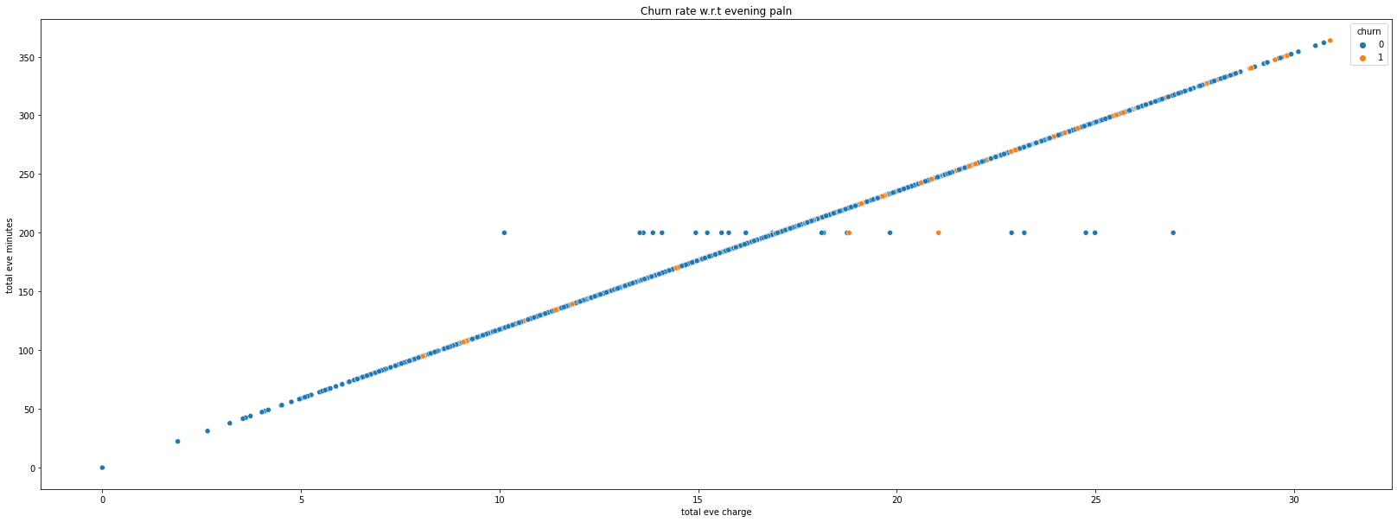
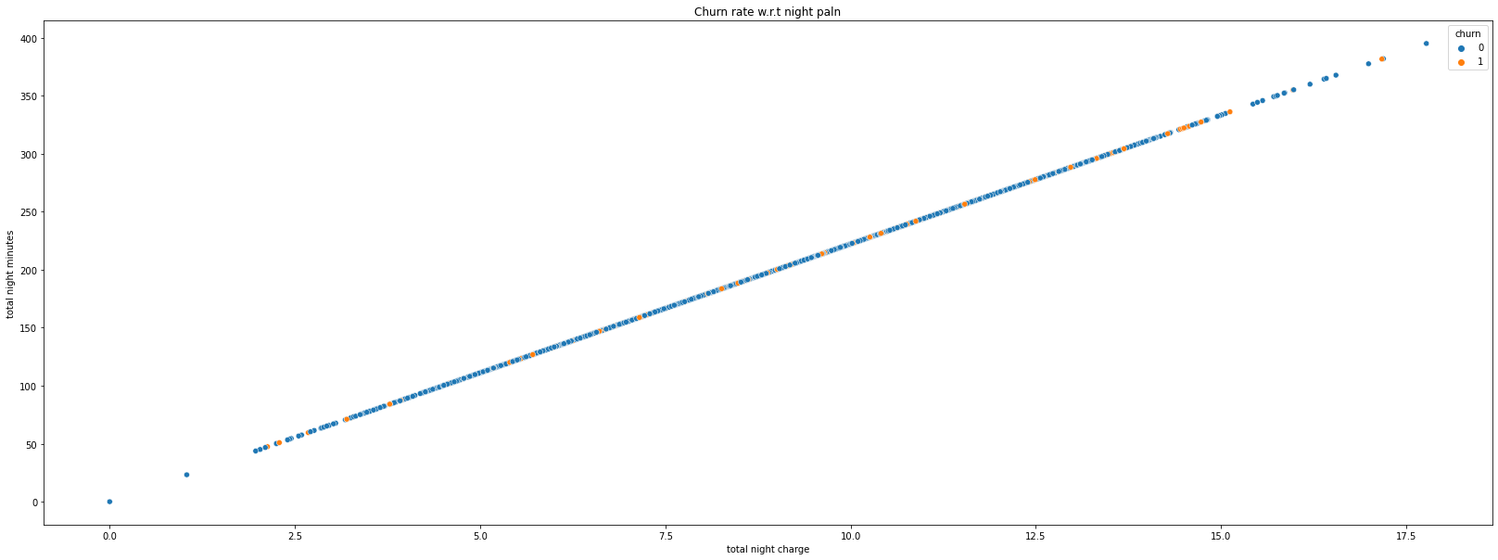
SCATTER PLOT ANALYSIS BETWEEN INTERNATIONAL PLAN,DAY PLAN,EVENING PLAN,NIGHT PLAN

Slide 11
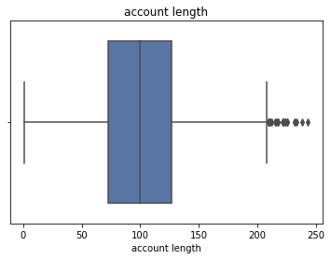
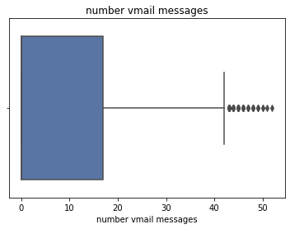
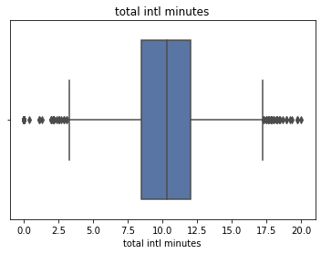
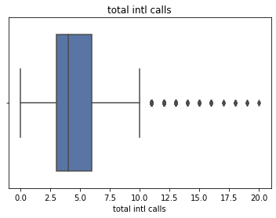
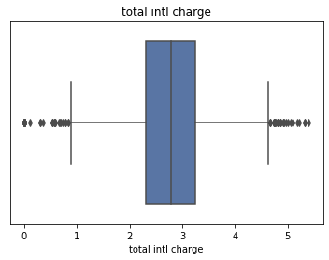
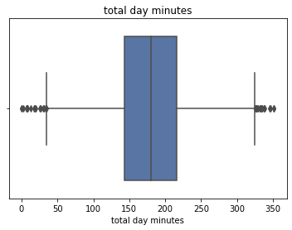
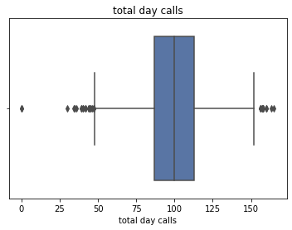
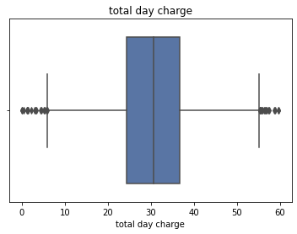
OUTLIER ANALYSIS :
Outliers are data points that are far from other data points

Slide 12

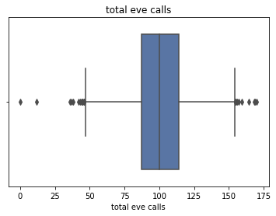
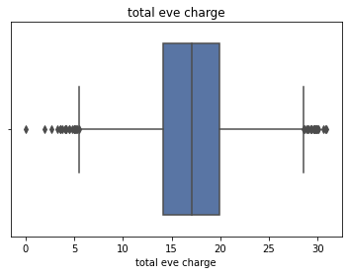
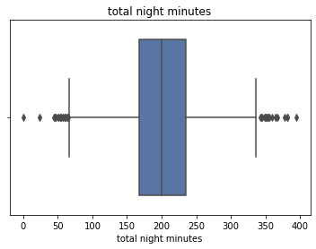
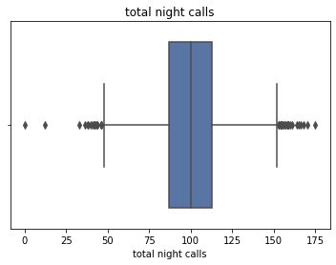
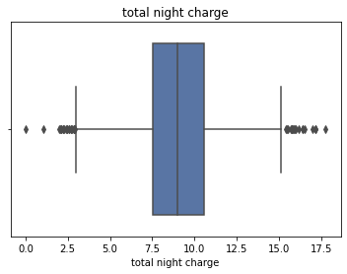
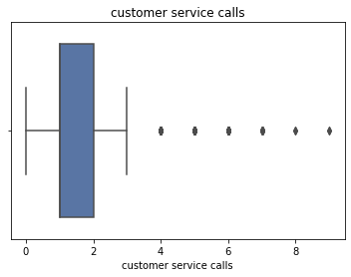

Slide 13
Outliers count according to churn(no,yes) column
Churn | Area . Code | Account .length | Voice. plan | Voice. messages | Intl. plan | Intl. mins | Intl. calls | Intl. charges | Days. mins | Days. calls
no | 0 | 9 | 0 | 7 | 274 | 33 | 296 | 44 | 28 | 26
yes | 0 | 3 | 0 | 0 | 199 | 3 | 66 | 4 | 9 | 3
Total | 0 | 12 | 0 | 7 | 473 | 36 | 362 | 48 | 37 | 29
Churn | Days. charge | Eve. mins | Eve. calls | Eve. charge | Night. mins | Night. calls | Night. charge | Customer. calls | Churn | Total
no | 30 | 47 | 27 | 89 | 49 | 30 | 64 | 19 | 0 | 820
yes | 10 | 4 | 1 | 18 | 9 | 2 | 10 | 32 | 0 | 373
Total | 40 | 51 | 28 | 107 | 58 | 32 | 74 | 51 | 0 | 820

Slide 14
TREATING OUTLIERS
From the above outlier graph we could infer that there outliers in the dataset which needs to be treated.
There is total 820 outliers point in which only 3(area code , voice plan, churn ) columns does not have any outliers
Now the outliers are treated by replacing the value of outliers with Nan and then imputing the outliers with their mean
Now we need to update the dataset by removing the correlated variables and the variable that doesn’t contain any meaningful information
The customer feature columns ‘state’, 'total day charge’, 'total eve charge’, 'total night charge’, 'total intl charge’ are dropped as it is not meaningful

Slide 15
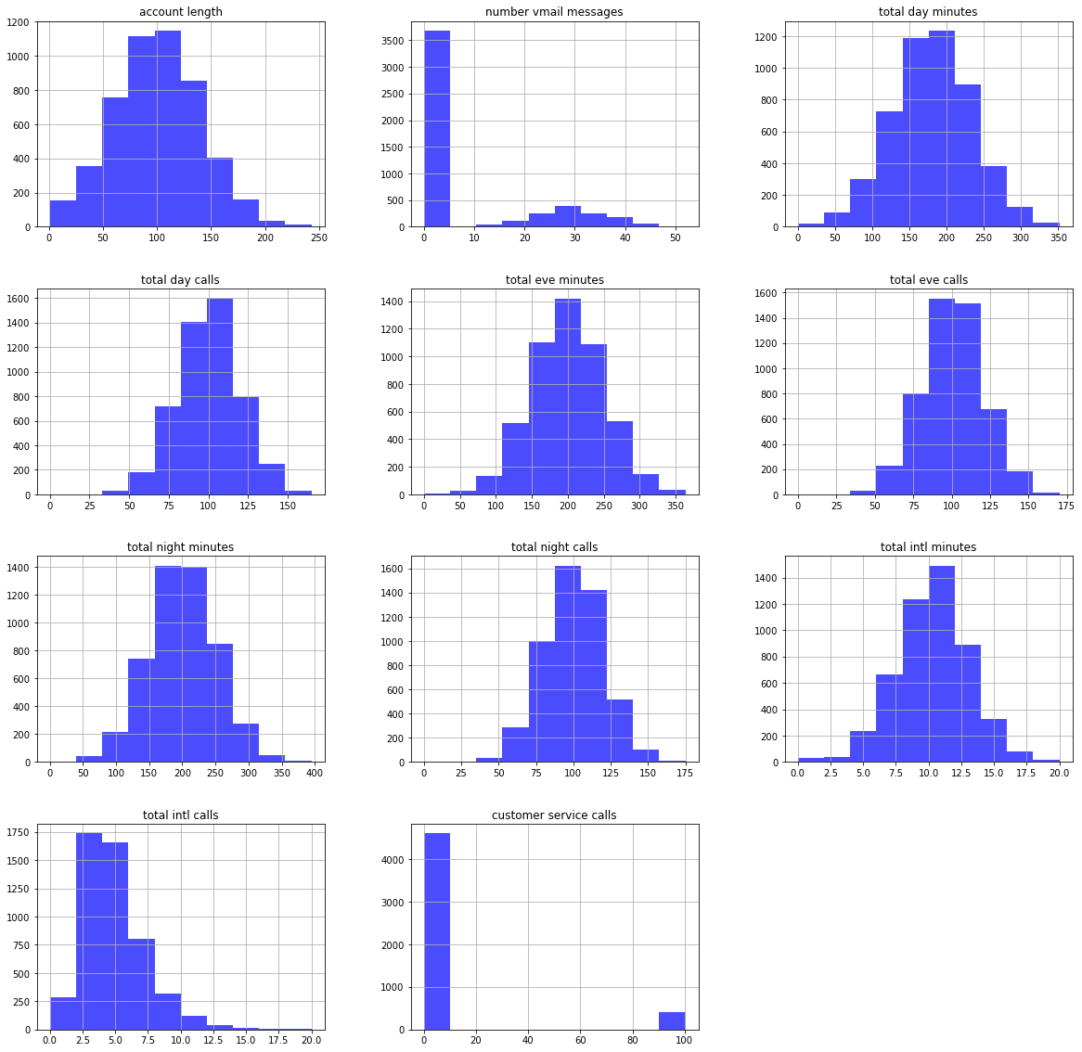
FEATURE SCALING
Distribution of customer features.

Slide 16
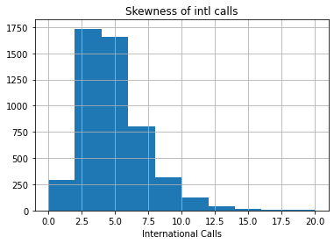
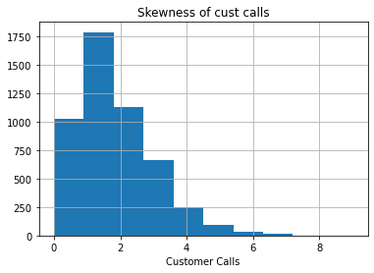
SKEWNESS
Skewness is a measure of the asymmetry of a distribution
This bar-plot indicates the skewness of International calls.
This bar-plot indicates the skewness of Customer calls.
Skewness = 1.361
Skewness = 1.042

Slide 17
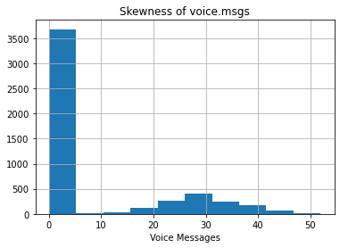
This bar-plot indicates the skewness of Voice messages.
Skewness = 1.35
For the above 3 features the skewness is high i.e. above 1
We will not do any log or sqrt transformation as these are discrete variables
Transformations are required only for continuous variables and continuous variables are all normally distributed.

Slide 18
FEATURE EXTRACTION

Slide 19
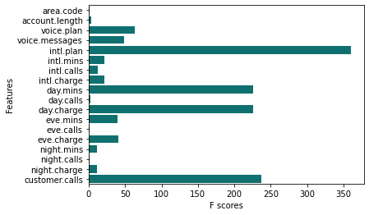
ANOVA:-
This test is a statistical method that separates observed variance data into different components to use for additional tests.
 | Features | F scores | Pvalues
4 | intl.plan | 360 | 0.000
17 | customer.calls | 237 | 0.000
8 | day.mins | 226 | 0.000
10 | day.charge | 226 | 0.000
2 | voice.plan | 63 | 0.000
3 | voice.messages | 49 | 0.000
13 | eve.charge | 41 | 0.000
11 | eve.mins | 40 | 0.000
5 | intl.mins | 21 | 0.000
7 | intl.charge | 21 | 0.000
6 | intl.calls | 12 | 0.001
14 | night.mins | 11 | 0.001
16 | night.charge | 11 | 0.001
1 | account.length | 3 | 0.134
9 | day.calls | 2 | 0.254
15 | night.calls | 1 | 0.621
12 | eve.calls | 1 | 0.657
0 | area.code | 1 | 0.471
Importance Features are:-International plan, day.mins, day.charges, customer calls

Slide 20
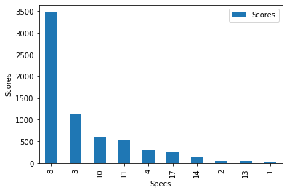
Chi Squared Test
The purpose of this test is to determine if a difference between observed data and expected data is due to chance.
 | Specs | Scores
8 | day.mins | 3474.569228
3 | voice.messages | 1127.545049
10 | day.charge | 601.285265
11 | eve.mins | 543.380119
4 | intl.plan | 303.963357
17 | customer.calls | 245.459832
14 | night.mins | 132.878281
2 | voice.plan | 45.058340
13 | eve.charge | 43.139769
1 | account.length | 35.321294
Importance Features are:-day.mins, voice.messages, day.charges.

Slide 21
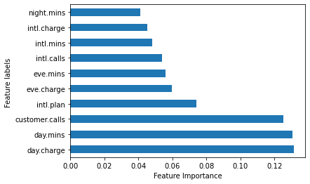
Extra Trees Classifier
The purpose of the this is to fit a number of randomized decision trees to the data, and in this regard is a from of ensemble learning. Particularly, random splits of all observations are carried out to ensure that the model does not overfit the data.
Feature Labels | Feature Importance
area.code | 0.021844
account.length | 0.034415
voice.plan | 0.018409
voice.messages | 0.016917
intl.plan | 0.073951
intl.mins | 0.048125
intl.calls | 0.054158
intl.charge | 0.045352
day.mins | 0.130705
day.calls | 0.034925
day.charge | 0.131405
eve.mins | 0.056046
eve.calls | 0.033857
eve.charge | 0.059698
night.mins | 0.041349
night.calls | 0.033376
night.charge | 0.040174
customer.calls | 0.125294
Importance Features are:-day.mins, customer.calls, day.charges.

Slide 22
S.No | TEST | FEATURE IMPORTANCE
1 | ANOVA | International plan, day.mins, day.charges, customer calls
2 | CHI-SQUARE | day.mins day.charges voice.messages
3 | EXTRA TREE CLASSIFIER | day.mins customer.calls day.charges
When we are compare with three test the best test is extra tree classifer , because here we are founding feature importance of day min , customer calls day charge’s

Slide 23
MODEL BUILDING

Slide 24
Sampling Techniques
Since the target variable (churn) is imbalanced, it is good to sample the minority class
Using SMOTE ( SMOTE: Synthetic Minority Over-sampling Technique)
Up sampling
Down sampling

Slide 25
Sampling results
UP-Sampling:- before up-sampling the count of label ‘1’ is 481
before up-sampling the count of label ‘0’ is 2869
:- after up-sampling the count of label ‘1’ is 2869
after up-sampling the count of label ‘0’ is 2869
Down- sampling:- before down-sampling the shape of x_train is 4293
before down-sampling the shape of x_test is 707
:- after down-sampling the shape of x_train is 3350
after down-sampling the shape of x_test is 1650

Slide 26
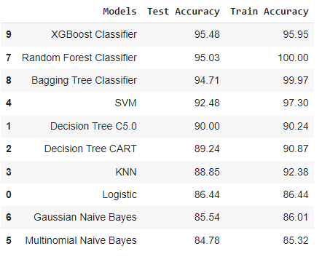
Test and train accuracy of various models fitted

Slide 27
MODEL SELECTION
By comparing all the models and choosing which model fits good
Types of models | Precision |  | Recall |  | F1 score |  | Support |  | Accuracy | Specifcity /True Negative Rate | Sensitivity /True Positive Rate | False Negative Rate | False Postive Rate
 | 0 | 1 | 0 | 1 | 0 | 1 | 0 | 1
Random forest | 0.96 | 0.92 | 0.99 | 0.72 | 0.97 | 0.80 | 1424 | 226 | 0.95 | 98.95 | 71.68 | 28.32 | 1.05
Logistic regression | 0.96 | 0.39 | 0.80 | 0.79 | 0.88 | 0.52 | 1424 | 226 | 80.24 | 80.48 | 78.76 | 21.24 | 19.52
KNN | 0.93 | 0.35 | 0.81 | 0.64 | 0.87 | 0.45 | 1424 | 226 | 0.78 | 80.76 | 64.16 | 35.84 | 19.24
Naive Bayes | 0.95 | 0.38 | 0.80 | 0.76 | 0.87 | 0.50 | 1424 | 226 | 0.79 | 79.92 | 76.11 | 23.89 | 20.08
XGBoost classifier | 0.97 | 0.86 | 0.98 | 0.79 | 0.97 | 0.83 | 1424 | 226 | 0.95 | 98.03 | 79.2 | 20.8 | 1.97
Bagged tree | 0.96 | 0.79 | 0.97 | 0.77 | 0.97 | 0.78 | 1424 | 226 | 0.94 | 96.6 | 76.99 | 23.01 | 3.3
SVM | 0.94 | 0.78 | 0.98 | 0.56 | 0.96 | 0.65 | 1424 | 226 | 0.86
Decision tree | 0.91 | 0.80 | 0.98 | 0.40 | 0.95 | 0.54 | 1424 | 226 | 0.90 | 98.38 | 40.27 | 59.73 | 1.62
From all the above models, the XGBoost classifier model is good in accuracy.
But by comparing all the metrics of F1 score, recall and precision we can conclude that XGBoost classfier model fits good than any other model.
From all the above models, the XGboost classifier model is good in accuracy.But by comparing all the metrics of F1 score, recall and precision we can conclude that Random forest model fits good than any other model.

Slide 28
Confusion matrix
Random forest: Xgboost classifier:
xgboost CLASSIFIER MODEL has a better prediction rate than the RANDOM FOREST classifier.
Churn | 0 | 1
0 | 1409 | 15
1 | 64 | 162
Churn | 0 | 1
0 | 1396 | 28
1 | 47 | 179

Slide 29
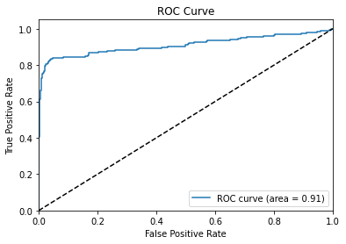
Final Model:
XGBoost classifier has the best accuracy and lowest false negative rate and also lowest false positive rate.Hence we’ll choose XGBoost Classifier.
After concluding our final model as XGBoost classifier algorithm we need to train our model with Optimum Parameters
ROC curve and AUC graph are used to understand the overall performance of our model which is given as below:

Slide 30
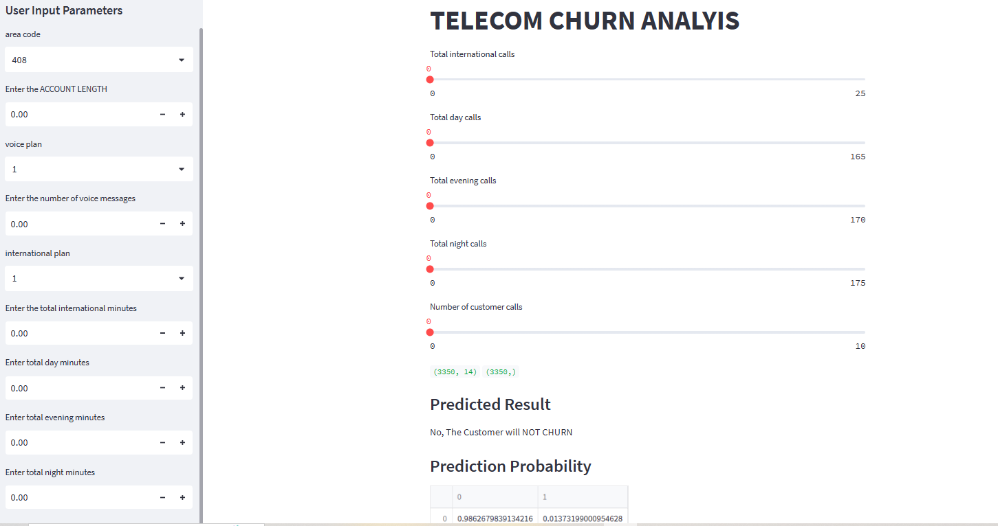
Model deployment
Using streamlit we deploy the final working model based on the features that had more importance on the dependent(Churn) variable.

Slide 31
THANK YOU

